Slide 1

Analyzing Amazon Sales data
Presented by
Archana G

Slide 2
Introduction
Sales management has gained importance to meet increasing competition and the need for improved methods of distribution to reduce cost and to increase profits. Sales management today is the most important function in a commercial and business enterprise.
I’ve just wrapped up an in-depth project at Unified Mentor , where I analyzed Amazon sales data spanning from 2010 to 2017 using Power BI. This was more than just numbers—it was about uncovering stories hidden in data.

Slide 3

Details of Data
Region
Country
Item Type
Sales Channel
Order Priority
Year
Order Date
Order ID
Ship Date
Units Sold
Unit Price
Unit Cost
Total Revenue
Total Cost
Total Profit

Slide 4


Main KPIs
Year wise sales
Sum of Total Revenue
Total units sold
Sum of Total profit
Top 10 region generating highest revenue
Top 5 items produced highest revenue
Profits based og mode of sales
Sum of unit sold by year and sales channel
Sum of Total revenue by year
Total unit sold by order priority
Sum of total profit by region and sales channel
Highest unit sold by item types
Number of orders by year

Slide 5
My Design

Slide 6
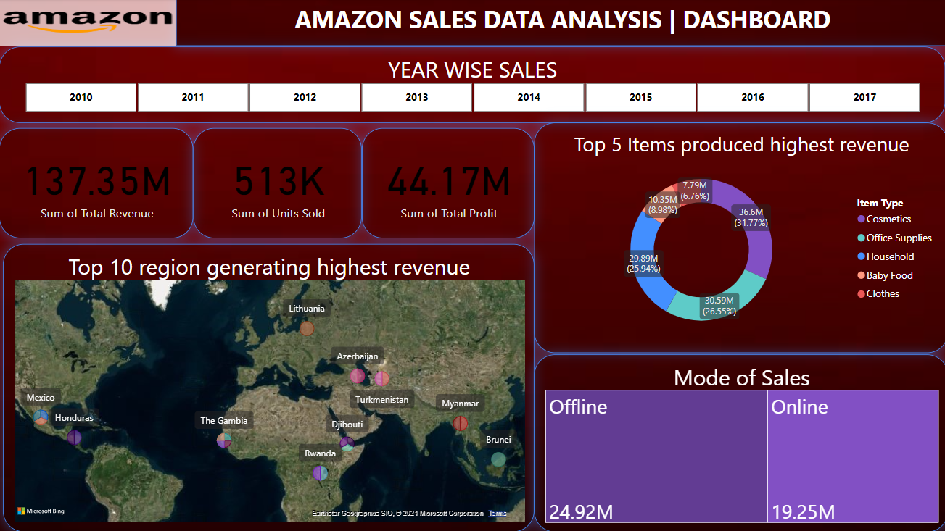

Slide 7
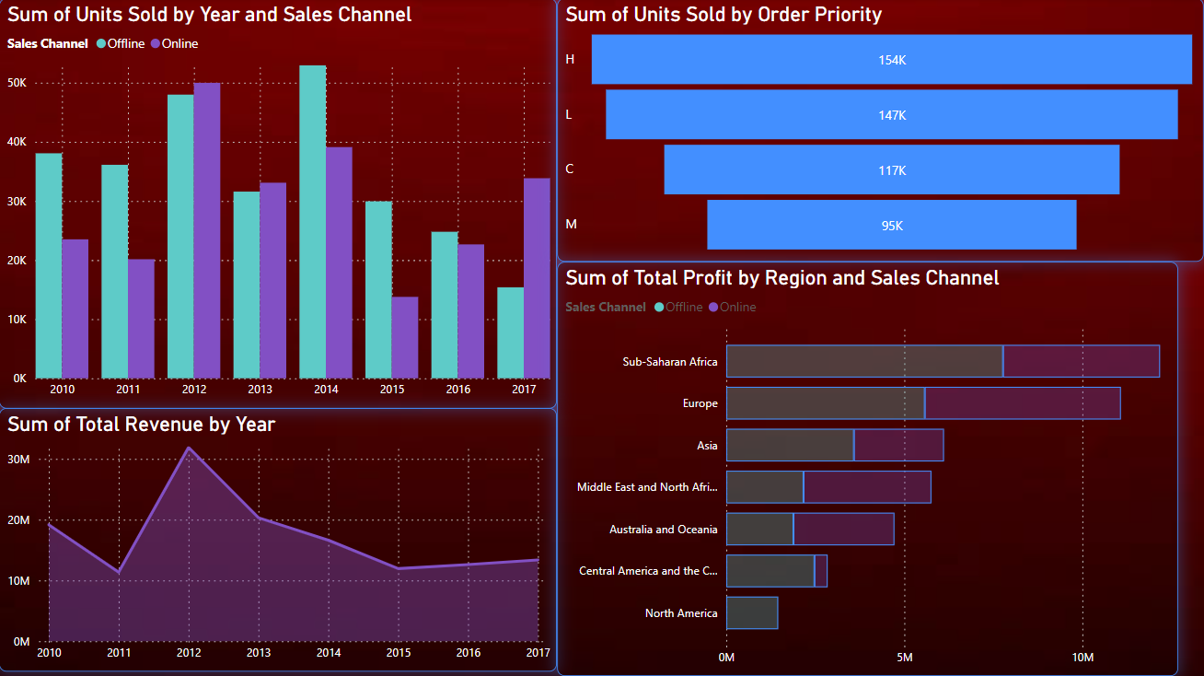

Slide 8
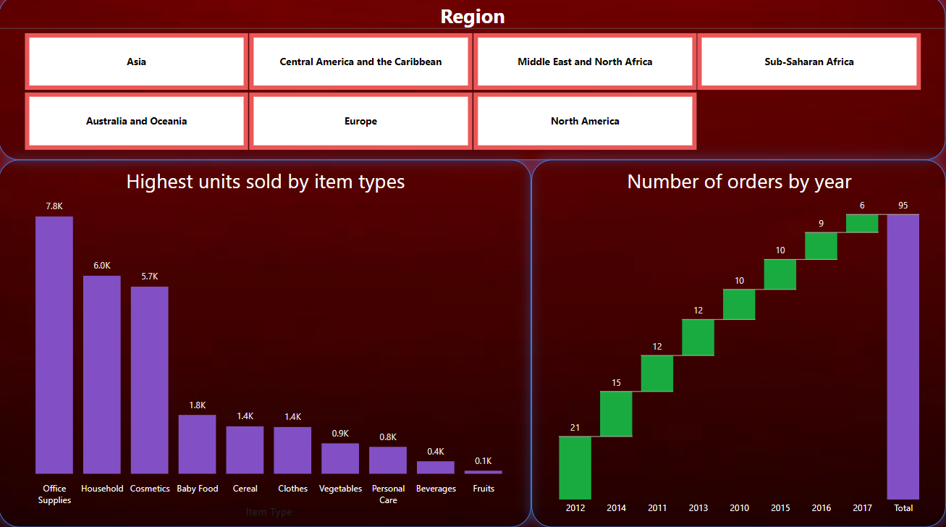

Slide 9

Thank you
Archana G
archanagajendra22@gmail.com

